Slide 1
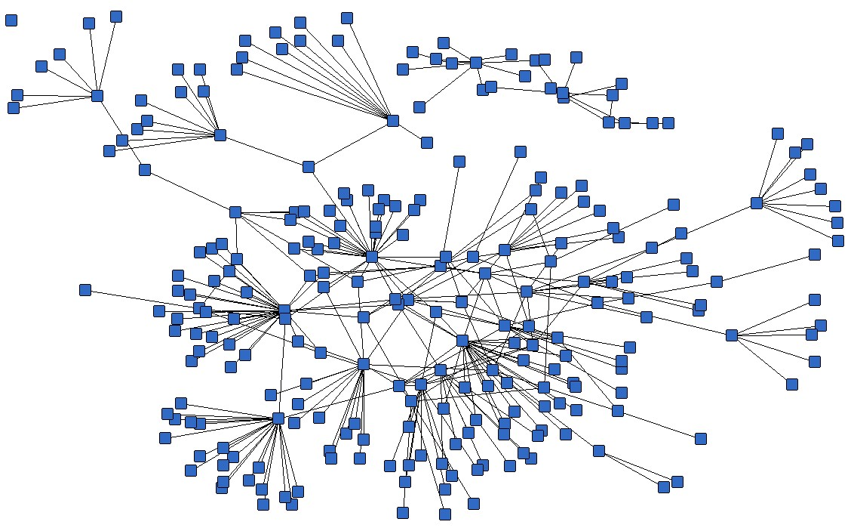
Road Network Analysis of Incheon
20121229 JunPyo Park
2018 1st semester Methods of Applied Mathematics | Prof. Bongsoo Jang
Notes:
Hello, I am JunPyo Park and I’ll talk about my midterm project.

Slide 2
Contents
1. Methods
2. Code Explanation
3. Results
3-1. Visual Analysis
3-2. Mathematical Analysis
4. Further Study
Notes:
This is the contents.

Slide 3
1. Methods
Gephi, Networkx, Folium
Notes:
First I introduce some method I used in my project.

Slide 4
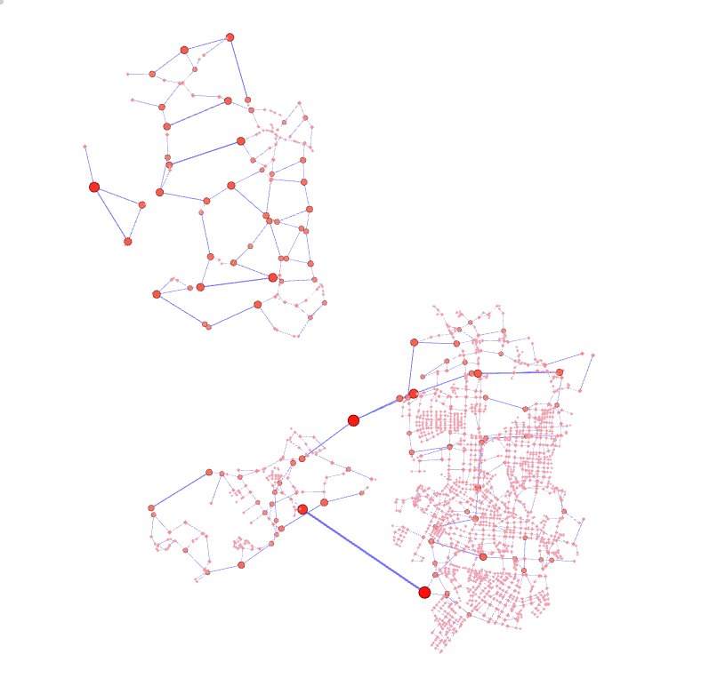
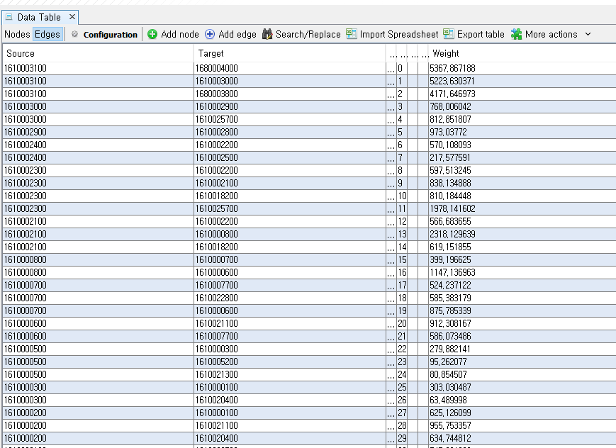
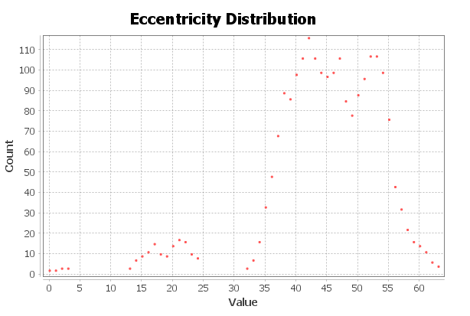
Road Network Analysis
Methods
Explanation
Results
Further Study
Gephi
Visualization and Analysis Tool
Graph Overview
Data Table
Result Analysis
Notes:
This is Gephi used for Visualization and Analysis tool

Slide 5
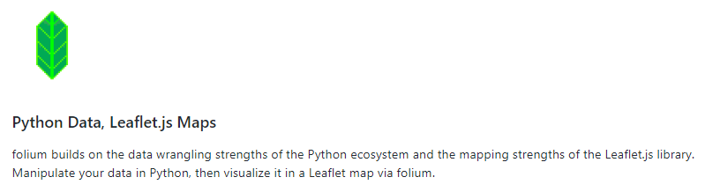
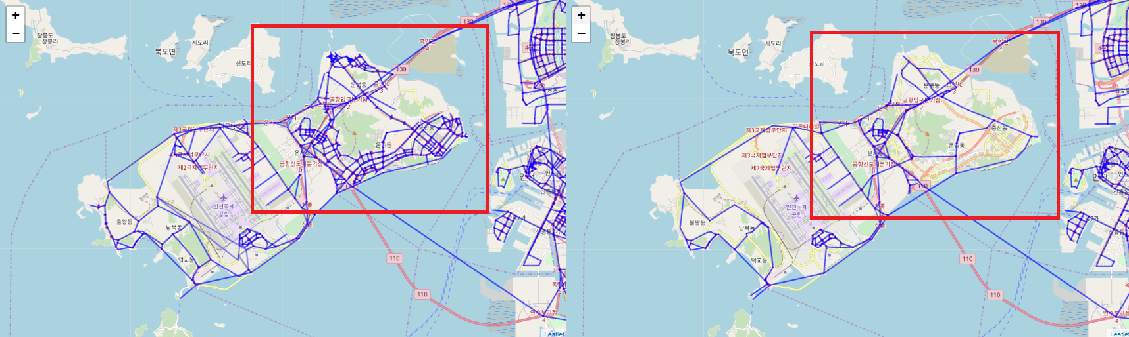
Road Network Analysis
Methods
Explanation
Results
Further Study
Folium
Notes:
Folium is python data visualization module, we can handle interactive map easily by using this.

Slide 6
2. Code Explanation
Brief Description
Notes:
Okay, this chapter, I’ll explain some part of my python code and logics

Slide 7
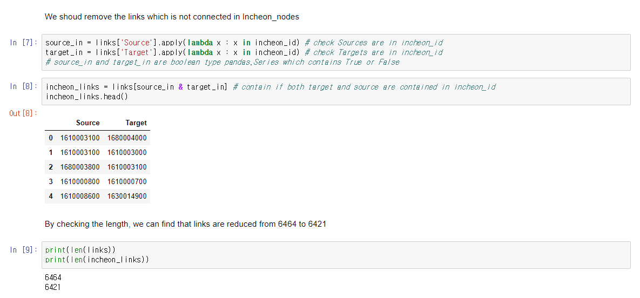
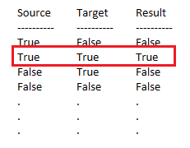
Road Network Analysis
Methods
Explanation
Results
Further Study
Exception Handling
Notes:
Okay, this is exception handling code, brief figure is like this
Because of ‘and’ notation here, we only select True, True for our links
You can find the number is reduced from 6464 to 6421

Slide 8
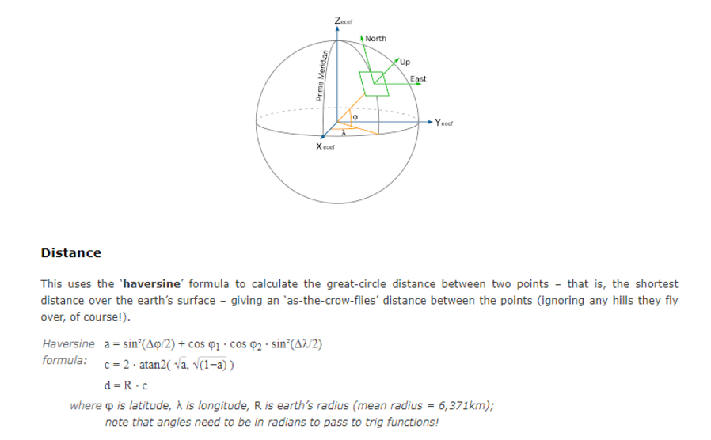
Road Network Analysis
Methods
Explanation
Results
Further Study
Calculating Road Length
-Assumption : The Earth is “sphere”
Notes:
I calculate the length between two nodes and add it for weight of each links.
In here assumption is The Earth is “sphere”, then we can apply this spherical coordinate length formula

Slide 9
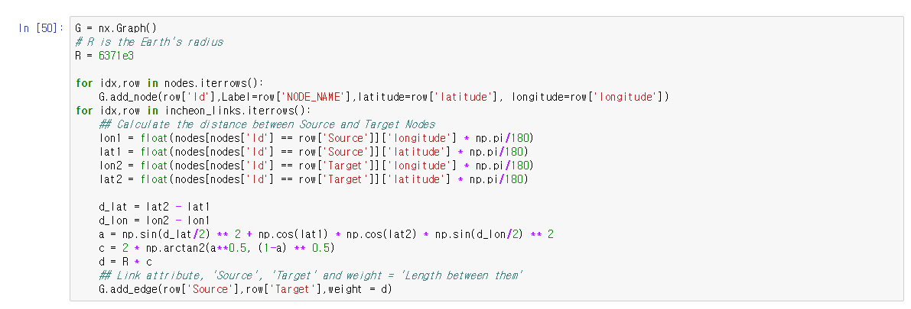
Road Network Analysis
Methods
Explanation
Results
Further Study
Calculating Road Length
Notes:
This is the Python code for calculating length between two nodes and I put this length into weight attribute

Slide 10
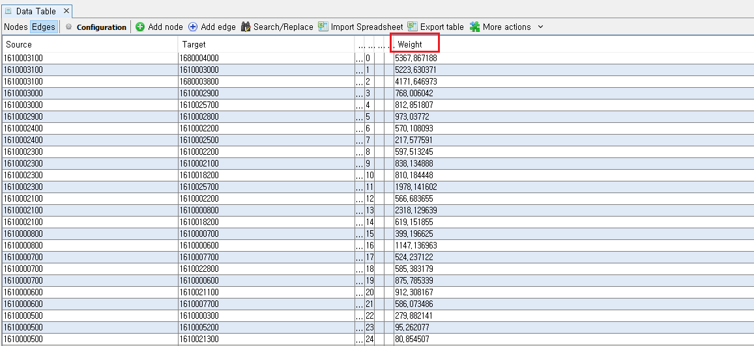
Road Network Analysis
Methods
Explanation
Results
Further Study
Edges Data Table
Notes:
You can see the weight attribute here, Gephi Edge data table

Slide 11
3. Result Analysis
3-1. Visual Analysis
Notes:
Okay, I’ll show some results.
First let’s take a look at visualization result.

Slide 12
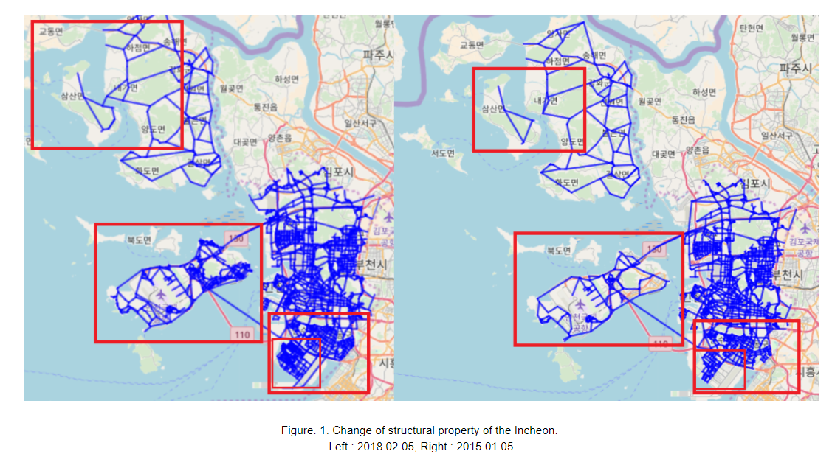
Visual Analysis
Methods
Explanation
Results
Further Study
Notes:
Okay this is the comparison of visualization result.
날짜 언급
Let’s take a look at one by one.

Slide 13
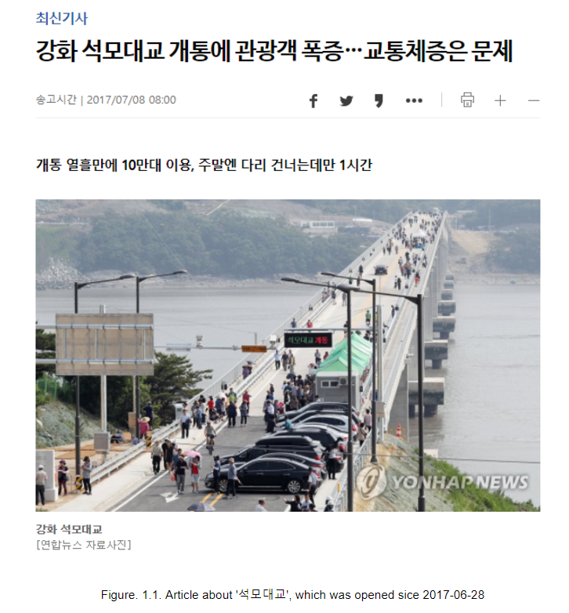
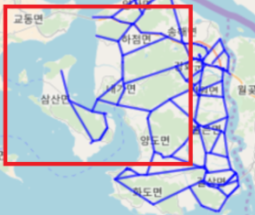
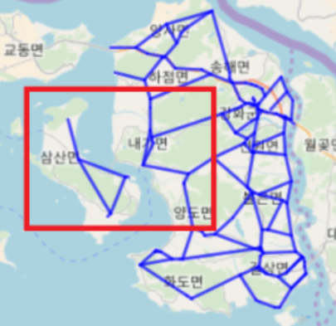
Visual Analysis
Methods
Explanation
Results
Further Study
Notes:
Okay, this Bridge name is '석모대교’ , we can find an article about ‘석모대교’ which was opened since 2017-06-28

Slide 14
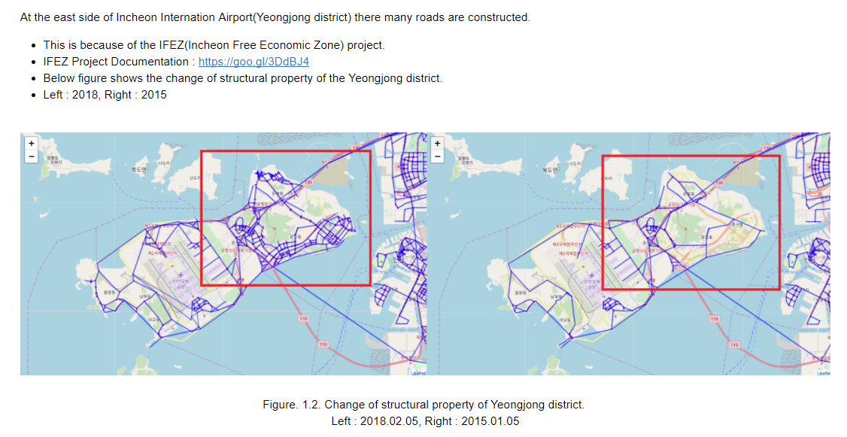
Visual Analysis
Methods
Explanation
Results
Further Study
Notes:
Let’s take a look at next spot, here is Yeongjong district and there many roads are constructed.

Slide 15
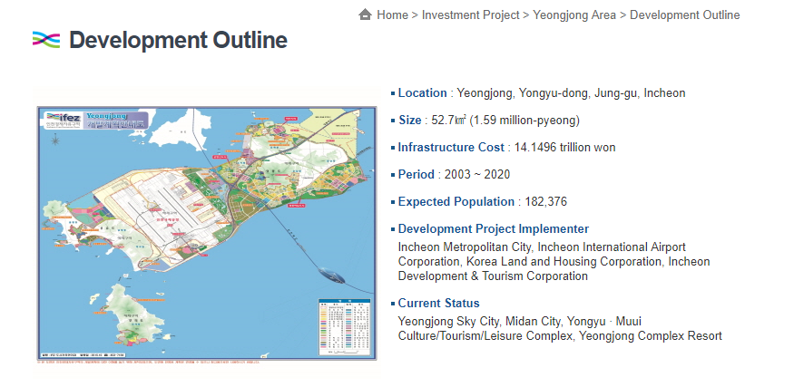
Visual Analysis
Methods
Explanation
Results
Further Study
Notes:
Here is the development outline for this project.

Slide 16
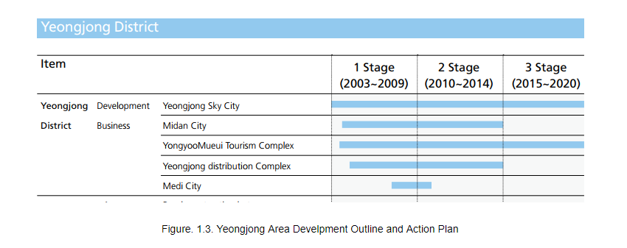
Visual Analysis
Methods
Explanation
Results
Further Study
Notes:
And this is corresponding action plan.

Slide 17
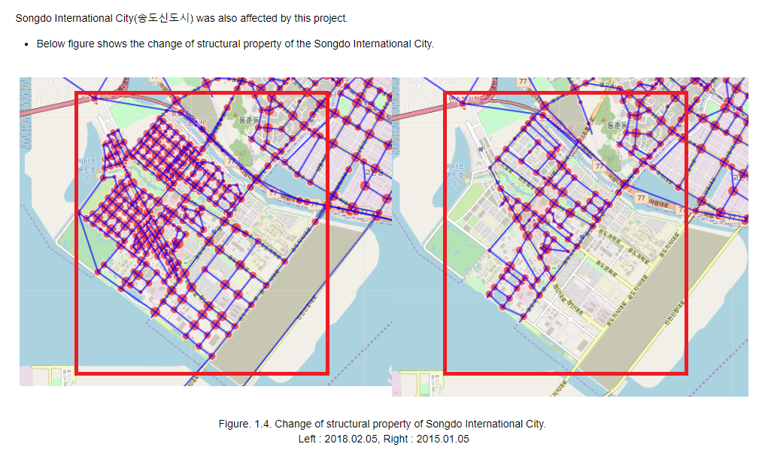
Visual Analysis
Methods
Explanation
Results
Further Study

Slide 18
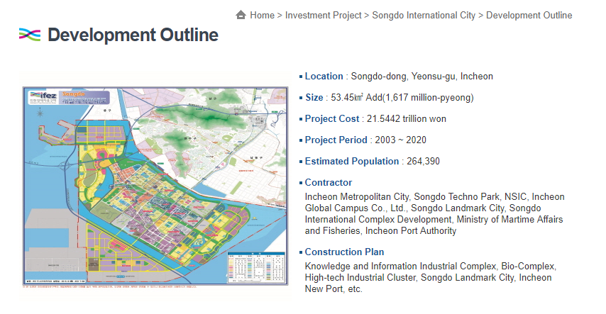
Visual Analysis
Methods
Explanation
Results
Further Study
Notes:
This is also a development outline

Slide 19
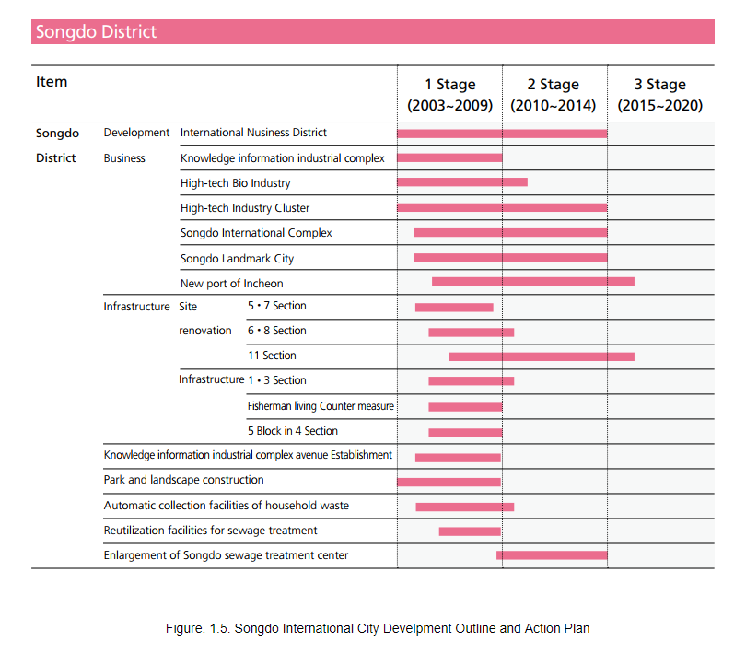
Visual Analysis
Methods
Explanation
Results
Further Study
Notes:
And this is action plan for Songdo District, one can see, now is in the 3rd stage

Slide 20
3. Result Analysis
3-2. Mathematical Analysis
Notes:
Okay next thing is Mathematical Analysis

Slide 21
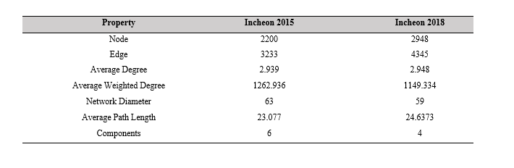
Mathematical Analysis
Methods
Explanation
Results
Further Study
Result Summary
Notes:
This is the brief summary of results.
Node, Edge, Average Degree are increasing.
However Average Weighted Degree is decreasing, we can interpret it as a “Oh there many short roads are constructed!”
Okay, let’s take look at other thing one by one.

Slide 22
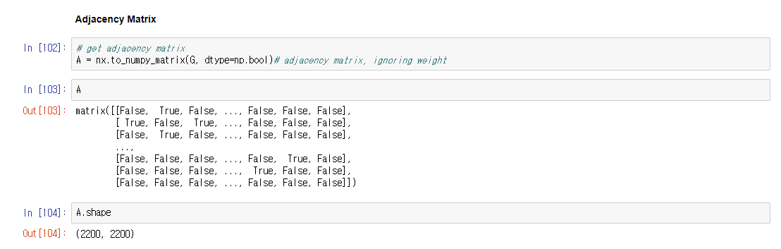
Mathematical Analysis
Methods
Explanation
Results
Further Study
Adjacency Matrix
Notes:
Using Networkx’s built in function we can get adj matrix A

Slide 23
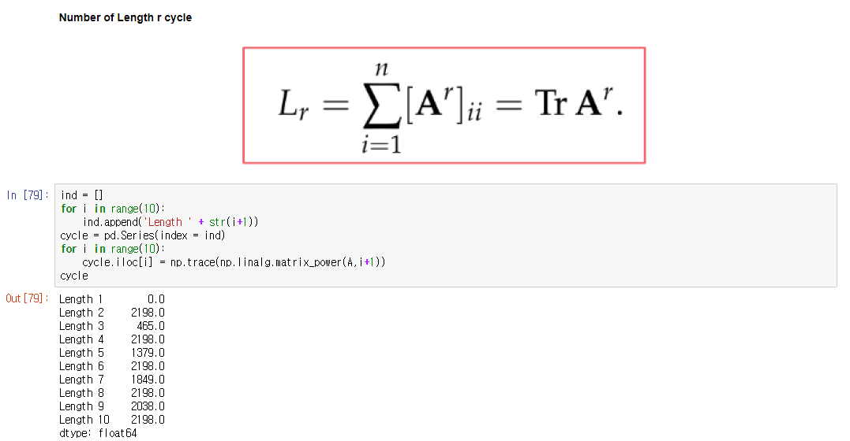
Mathematical Analysis
Methods
Explanation
Results
Further Study
Number of Length r Cycles
Notes:
I find length r cycles, using this formula

Slide 24
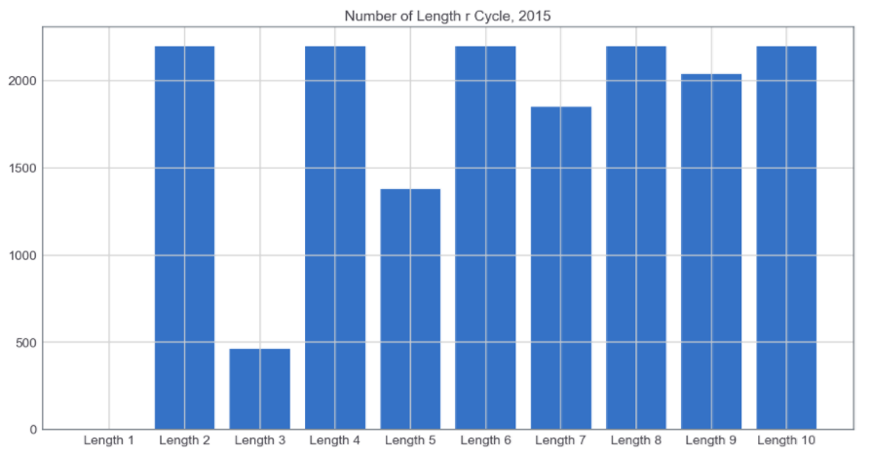
Mathematical Analysis
Methods
Explanation
Results
Further Study
Number of Length r Cycles_2015
Notes:
This is the result of 2015, in here you can see all even length has same number of cycles.
It is very trivial result (up down) * n

Slide 25
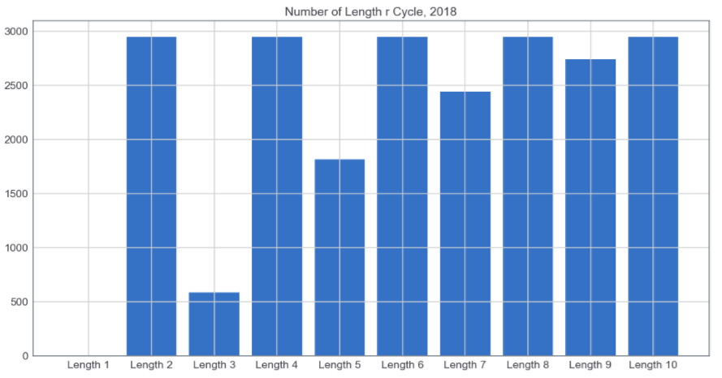
Mathematical Analysis
Methods
Explanation
Results
Further Study
Number of Length r Cycles_2018
Notes:
Same for 2018

Slide 26
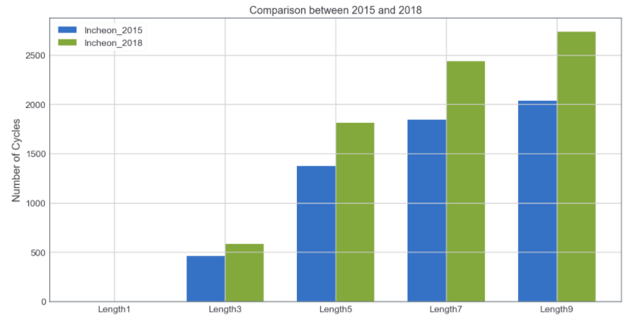
Mathematical Analysis
Methods
Explanation
Results
Further Study
Comparison
Notes:
And this is comparison result as we expected, in 2018 the number of length r cycles is larger than 2015

Slide 27

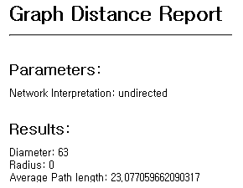
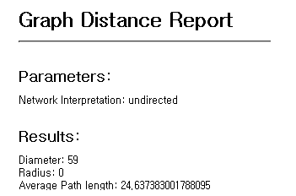
Mathematical Analysis
Methods
Explanation
Results
Further Study
Network Diameter
2015
2018
Notes:
Here is the definition of network diameter and result
Diameter is decreasing and average path length is increasing little bit

Slide 28
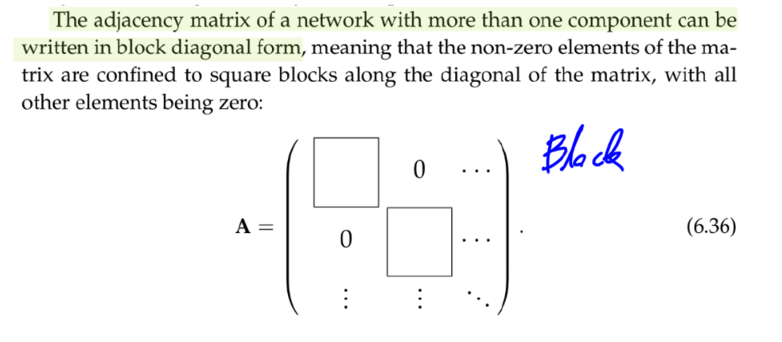
Mathematical Analysis
Methods
Explanation
Results
Further Study
Component Analysis
Notes:
Component could be calculated by make the adj matrix to block_diagonal form (with edge order permutation)
Then number of block is components

Slide 29
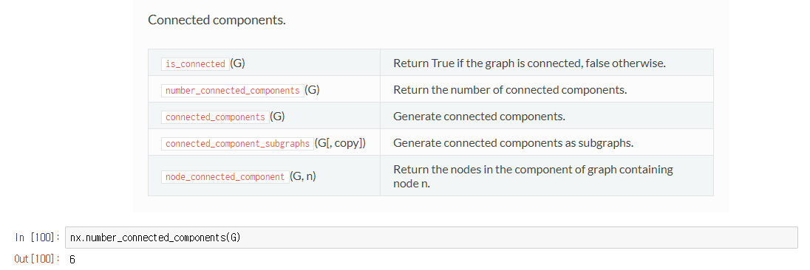
Mathematical Analysis
Methods
Explanation
Results
Further Study
Component Analysis using Networkx
Notes:
Networkx support this number_connected_components function

Slide 30
Mathematical Analysis
Methods
Explanation
Results
Further Study
Component Analysis using Networkx
In 2015, there are 6 components.
In 2018, there are 4 components.
-> There are two components reduction.
Notes:
There are two components reduction.
I don’t know where the one came from but I exactly know where the other one is came from
It is obviously due to the constuction of '석모대교'

Slide 31

5. Further Study
Some topics
Notes:
Okay, let’s see the further study topics

Slide 32
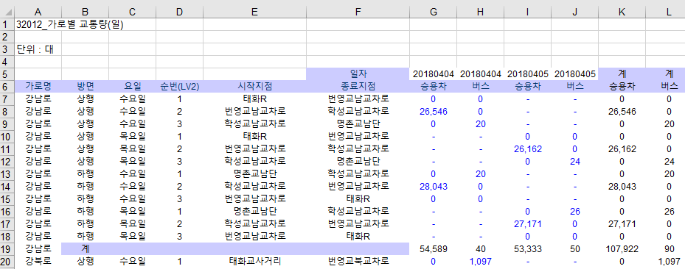
Further Study
Methods
Explanation
Results
Further Study
Flow Analysis (Graph Laplacian)
Need to combine traffic data at the link.
Notes:
First is flow analysis
We need to combine traffic data at the link for doing this.
This dataset needed to be pre processed to fit our node-link dataset.
Our data is undirected but this are direct data set it has direction 상행, 하행

Slide 33
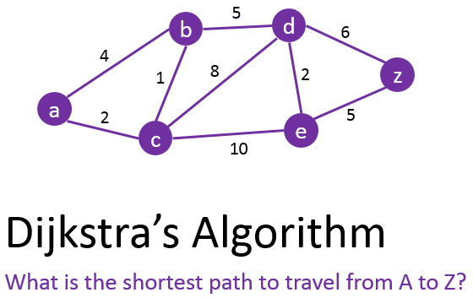
Further Study
Methods
Explanation
Results
Further Study
Finding Best Path
Shortest Length Path -> Possible Now
Shortest Time Path -> Average Speed is needed
Notes:
Next topic is finding best path.
There are two kinds of best path, first is shortest length path and second is shortest time path.
Applying algorithm here is same “Dijkstra’s Algorithm”
Since we use ‘length’ to our link’s weight, we can do the first one, but second case, we have to know the consuming time for passing each link.
To do so, we have to know the average speed for each road.

Slide 34
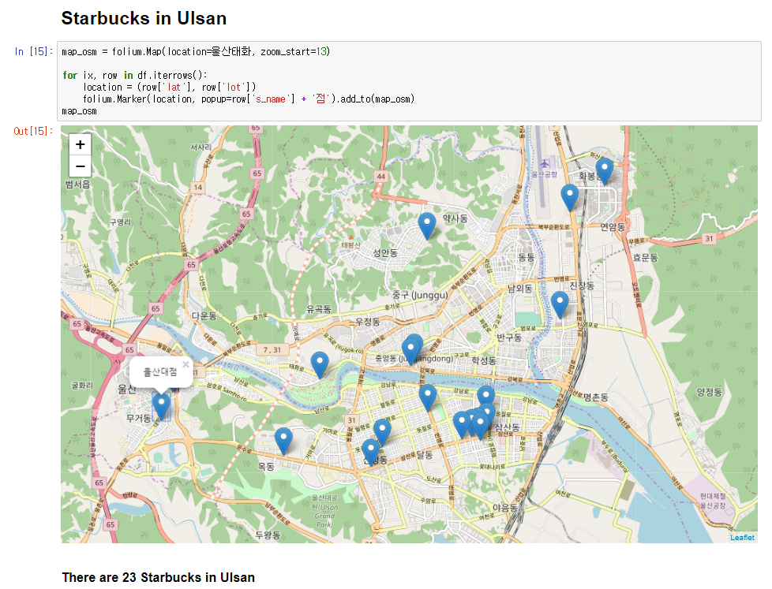
Further Study
Methods
Explanation
Results
Further Study
Business Location Analysis
Notes:
Last one is “Business Location Analysis”, this figure shows the 23 STARBUCKS at Ulsan.
If we combine traffic, population density or other data, we can do some analysis of STARBUCKS location and may find out the rule of STARBUCS’s location selection strategy.

Slide 35
Question?

Slide 36
Thank you

